Slide 1
CS315 Lecture 4

Slide 2
Types of web application
The web application has two types which are :
static web sites : the content of it’s pages are written at the design time, this information will stay, as it is until the developer changes it, this can be developed for personal sites, small companies sites … etc.
Dynamic web sites: the content of it’s pages changes depending on a database, that means every time we change the data inside the database the site will view the new information, this kind can be used for developing a news sites, sports sites, commercial sites, universities … etc.

Slide 3
Languages of Web designing
Design Language (HTML):
Hyper Text Markup Language (HTML) is one of the most known and easy designing languages (which also called Markup Languages). It contains number of commands that is called Tags, each tag gives a certain output.
Scripting Languages :
A script language is an embedded language that we use it to add more action to our site (events and events handlers), there are two types of scripting languages that is Client Side Scripts (CSS) and Server Side Scripts (SSS).

Slide 4
Scripting Languages
Client Side Scripts (CSS) :
It’s called like that because the browser in the client translates it. It gives the web page the power of interactivity; for example JavaScript, VBScript.
Server Side Script (SSS)
this kind of scripting is translated on the server, which is used to perform the programmatic tasks on the information that comes to and from the Web server . this scripts makes the information exchange between the Web site and the user.
CGI, Perl, ASP and PHP are the examples of this type of scripts

Slide 5
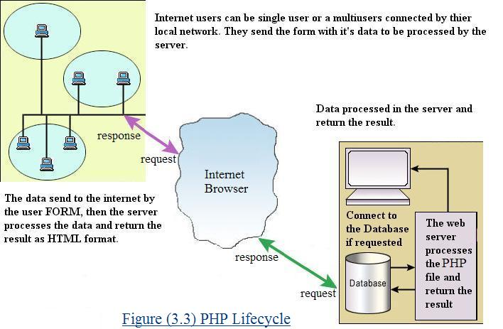
Server-Side Processing
php

Slide 6
Scripting Languages
Server-side script
Is executed by the server before the web page is downloaded to the browser.
Receives information passed to it from the browser or from files and also it’s deals with databases which is available to it on the server.
Can be stored alone in a file like ASP file or embedded in a web page
Client-side script
Is executed by the browser either before the browser displays the page or when the user clicks a button or performs another action on the page
Embedded in a web page

Slide 7
What is an HTML File?
HTML stands for Hyper Text Markup Language
An HTML file is a text file containing small markup tags
The markup tags tell the Web browser how to display the page
An HTML file must have an htm or html file extension
An HTML file can be created using a simple text editor

Slide 8
The HTML Tag
An HTML tag is a code element that tells the Web browser what to do with your text.
Example: <center>, <body>
HTML tags are surrounded by the two characters < and >
HTML tags normally come in pairs like <b> and </b> “but this is not an absolute rule”
The text between the start and end tags is the element content.
They are not case sensitive.
Spaces, and line breaks are ignored.
an HTML element is everything between the start tag and the end tag, including the tags:
Ex: <p>This is a paragraph.</p>

Slide 9
HTML Structure
<HTML>
Tells the Web browser that this is the beginning of an HTML document
<Head>
Contains information about the document (base, link, meta, script, style, and title)
Is not displayed by a browser
<TITLE>
This element defines the title of the document.
<Body>
Contains the text, links, and graphics
Is displayed on the page

Slide 10
Creating a Simple Page
Once you have the proper program (any text editor)open on your screen, type the following HTML text into the window:
<html>
<head>
<title>My First Page</title>
</head>
<body>
Hello. This is my first page!
</body>
</html>

Slide 11
Creating a Simple Page
Note:
Does not make a difference whether you put the tags or you use uppercase or lowercase letters.
In HTML a new line and any number of spaces counts as one space.
Save it to the filename mypage.html.
Use internet browser to display the page.

Slide 12
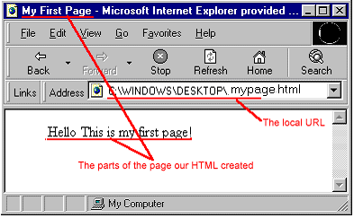
Creating a Simple Page

Slide 13
Creating a Simple Page
The following pieces of code gives same result as last example
<html>
<head>
<title>
My First Page
</title>
</head>
<body>
Hello. This is my
first page!
</body>
</html
<html>
<head>
<title>
My First Page
</title>
</head>
<body>
Hello.
This
is
my
first page!
</body>
</html

Slide 14
Tag Attributes
Tags can have attributes. Attributes can provide additional information about the HTML elements on your page.
Attributes always come in name/value pairs like this: name="value".
<body bgcolor="red">
This tag defines or tell the browser that the background color of the page should be red .
Attributes are always added to the start tag of an HTML element.

Slide 15
HTML Versions
Version | Year
HTML | 1991
HTML+ | 1993
HTML 2.0 | 1995
HTML 4.0 | 1997
HTML 4.01 | 1999
XHTML 1.0 | 2000
XHTML 1.1 | 2001
HTML5 | 2012
XHTML5 | 2013

Slide 16
The <!DOCTYPE> Declaration
It helps the browser to display a web page correctly. There are many different documents on the web, and a browser can only display an HTML page 100% correctly if it knows the HTML type and version used.
<!DOCTYPE> is not an HTML tag; it is an instruction to the web browser about what version of HTML the page is written in.
In (HTML 4.01/XML ) it refers to a DTD(Document Type Definition ) , because HTML 4.01 was based on SGML(Standard Generalized Markup Language). The DTD specifies the rules for the markup language
HTML5 is not based on SGML, and therefore does not require a reference to a DTD

Slide 17
Common DOCTYPE Declarations
HTML 4.01 Strict
This DTD contains all HTML elements and attributes, but does NOT INCLUDE presentational or deprecated elements (like font). Framesets are not allowed.
< !DOCTYPE HTML PUBLIC "-//W3C//DTD HTML 4.01//EN"
"http://www.w3.org/TR/html4/strict.dtd">
HTML 4.01 Transitional
This DTD contains all HTML elements and attributes, INCLUDING presentational and deprecated elements (like font). Framesets are not allowed.
< !DOCTYPE HTML PUBLIC "-//W3C//DTD HTML 4.01 Transitional//EN" "http://www.w3.org/TR/html4/loose.dtd">
HTML 4.01 Frameset
The DTD is equal to HTML 4.01 Transitional, but allows the use of frameset content.
< !DOCTYPE HTML PUBLIC "-//W3C//DTD HTML 4.01 Frameset//EN" "http://www.w3.org/TR/html4/frameset.dtd">

Slide 18
Continue…
XHTML 1.0 Strict
< !DOCTYPE html PUBLIC "-//W3C//DTD XHTML 1.0 Strict//EN" "http://www.w3.org/TR/xhtml1/DTD/xhtml1-strict.dtd">
XHTML 1.0 Transitional
< !DOCTYPE html PUBLIC "-//W3C//DTD XHTML 1.0 Transitional//EN" "http://www.w3.org/TR/xhtml1/DTD/xhtml1-transitional.dtd">
XHTML 1.0 Frameset
This DTD is equal to XHTML 1.0 Transitional, but allows the use of frameset content.
< !DOCTYPE html PUBLIC "-//W3C//DTD XHTML 1.0 Frameset//EN" "http://www.w3.org/TR/xhtml1/DTD/xhtml1-frameset.dtd">
HTML 5
< !DOCTYPE html>
Not: The <!DOCTYPE> declaration must be the very first thing in your HTML document, before the <html> tag.

Slide 19
XHTML
What Is XHTML?
XHTML stands for Extensible Hyper text Markup Language
XHTML is almost identical to HTML 4.01
XHTML is a stricter and cleaner version of HTML 4.01
XHTML is HTML defined as an XML application
XHTML is supported by all major browsers.

Slide 20
Why XHTML?
Extensibility
HTML (an SGML application), any addition of a new group of elements requires to alter the entire DTD. In an XHML: all that is required is that the new set of elements be internally consistent and well-formed to be added to an existing DTD.
Portability
Today's market consists of different browser technologies. Some browsers run on computers, and some browsers run on mobile phones or other small devices. Smaller devices often lack the resources or power to interpret a "bad" markup language.
Therefore - by combining the strengths of HTML and XML, XHTML was developed. XHTML is HTML redesigned as XML.

Slide 21
EX: an XHTML document example with a minimum of required tags
<!DOCTYPE html PUBLIC "-//W3C//DTD XHTML 1.0 Transitional//EN" "http://www.w3.org/TR/xhtml1/DTD/xhtml1-transitional.dtd"> < html xmlns="http://www.w3.org/1999/xhtml"> < head> < title>Title of document</title> < /head> < body> ...... < /body> < /html>

Slide 22
XHTML rules
Document Structure
XHTML DOCTYPE is mandatory
The XML namespace attribute in <html> is mandatory
<html>, <head>, <title>, and <body> is mandatory
XHTML Elements
XHTML elements must be properly nested
XHTML elements must always be closed : break: <br />
XHTML elements must be in lowercase
XHTML documents must have one root element
XHTML Attributes
Attribute names must be in lower case
Attribute values must be quoted
Attribute minimization is forbidden
<option selected = "selected">

Slide 23
HTML5
HTML5 will be the new standard for HTML.
The previous version of HTML, HTML 4.01, came in 1999. The web has changed a lot since then.
HTML5 is still a work in progress. However, the major browsers support many of the new HTML5 elements .
HTML5 is a cooperation between the World Wide Web Consortium (W3C) and the Web Hypertext Application Technology Working Group (WHATWG).
WHATWG was working with web forms and applications, and W3C was working with XHTML 2.0. In 2006, they decided to cooperate and create a new version of HTML.

Slide 24
Some rules for HTML5 were established:
New features should be based on HTML, CSS, DOM, and JavaScript
Reduce the need for external plugins (like Flash)
Better error handling
More markup to replace scripting
HTML5 should be device independent
The development process should be visible to the public

Slide 25
Minimum HTML5 Document
<!DOCTYPE html> < html> < head> < title>Title of the document</title> < /head> < body> The content of the document...... < /body> < /html>

Slide 26
HTML5 - New Features
The <canvas> element for 2D drawing
The <video> and <audio> elements for media playback
Support for local storage ( in html5 web pages can store data locally within the user's browser)
It introduces application cache (it is a web application is cached, and accessible without an internet connection)
New content-specific elements, like <article>, <footer>, <header>, <nav>, <section>
New form controls, like calendar, date, time, email, url, search
The Web Workers (it is a JavaScript running in the background,
without affecting the performance of the page)

Slide 27
Headings
Headings are defined with the <h1> to <h6> tags.
<h1>This is a heading 1</h1>
<h2>This is a heading 2</h2>
<h3>This is a heading 3</h3>
<h4>This is a heading 4</h4>
<h5>This is a heading 5</h5>
<h6>This is a heading 6</h6>
HTML automatically adds an extra blank line before and after a heading.

Slide 28
Headings
This is a heading 1
This is a heading 2
This is a heading 3
This is a heading 4
This is a heading 5
This is a heading6

Slide 29
Paragraphs
Paragraphs are defined with the <p> tag.
<p>This is a paragraph one</p>
<p>This is another paragraph two</p>
HTML automatically adds an extra blank line before and after a paragraph.

Slide 30
Line Breaks
The <br> tag is used when you want to end a line, but don't want to start a new paragraph.
<br>This is line one
<br>This is line two
The <br> tag is an empty tag. It has no closing tag.

Slide 31
Comments in HTML
The comment tag is used to insert a comment in the HTML source code.
<!-- This is a comment -->
Note that you need an exclamation point after the opening bracket, but not before the closing bracket.

Slide 32
Bold, Italics, Big, Small, Underline and Horizontal
Make any piece of text bold by adding the tag.
This is <b>bold</b>.
To italicize, use these tags.
This is <i>italicized</i>.
<big>Big text</big>
<small>Small text</small>
To underline, use these tags
This is <u>underlined</u>.
Creates a horizontal line
This is a horizontal line: <hr>

